Slide 1
Noam Chomsky
on Language
A presentation by Otto Mättas

Slide 2
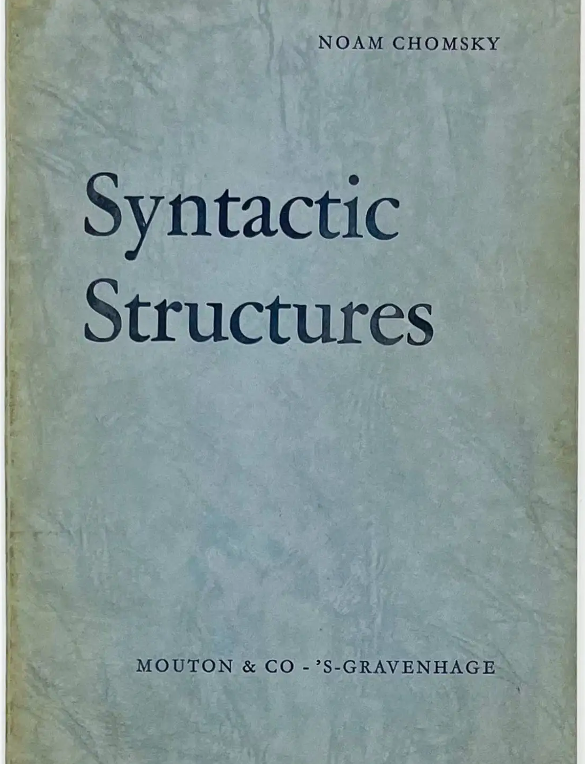
Exploring the Foundations of Generative Grammar
Chomsky’s theories of grammar and language are often referred to as generative, transformational, or transformational-generative. In a mathematical sense, generative means formally explicit. In the case of language, however, the meaning of the term typically also includes the notion of productivity — i.e., the capacity to produce an infinite number of grammatical phrases and sentences using only finite means (e.g., a finite number of principles and parameters and a finite vocabulary).

Slide 3
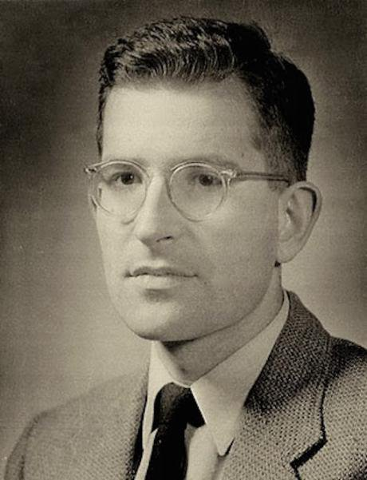
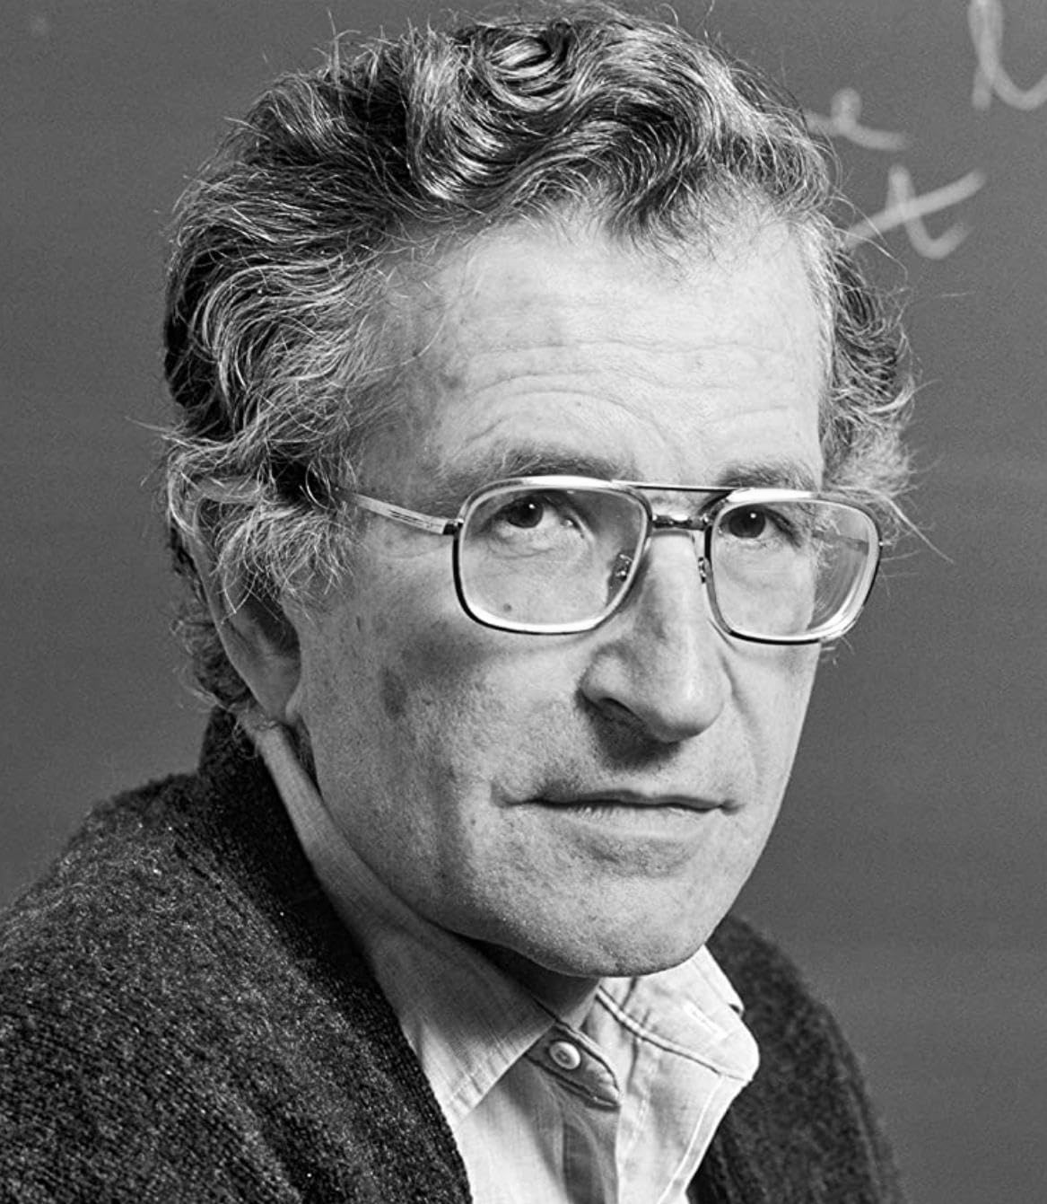
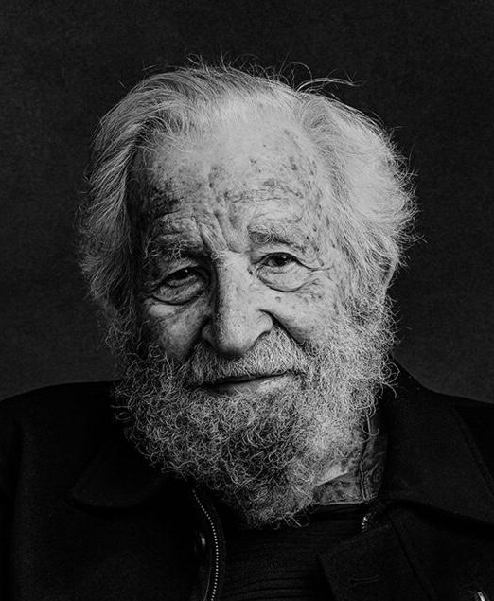
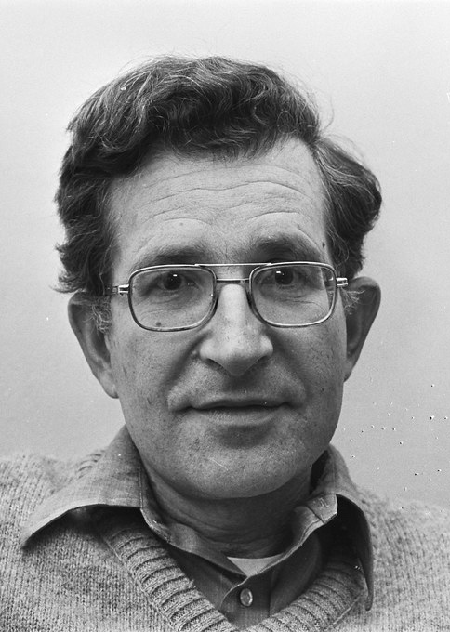
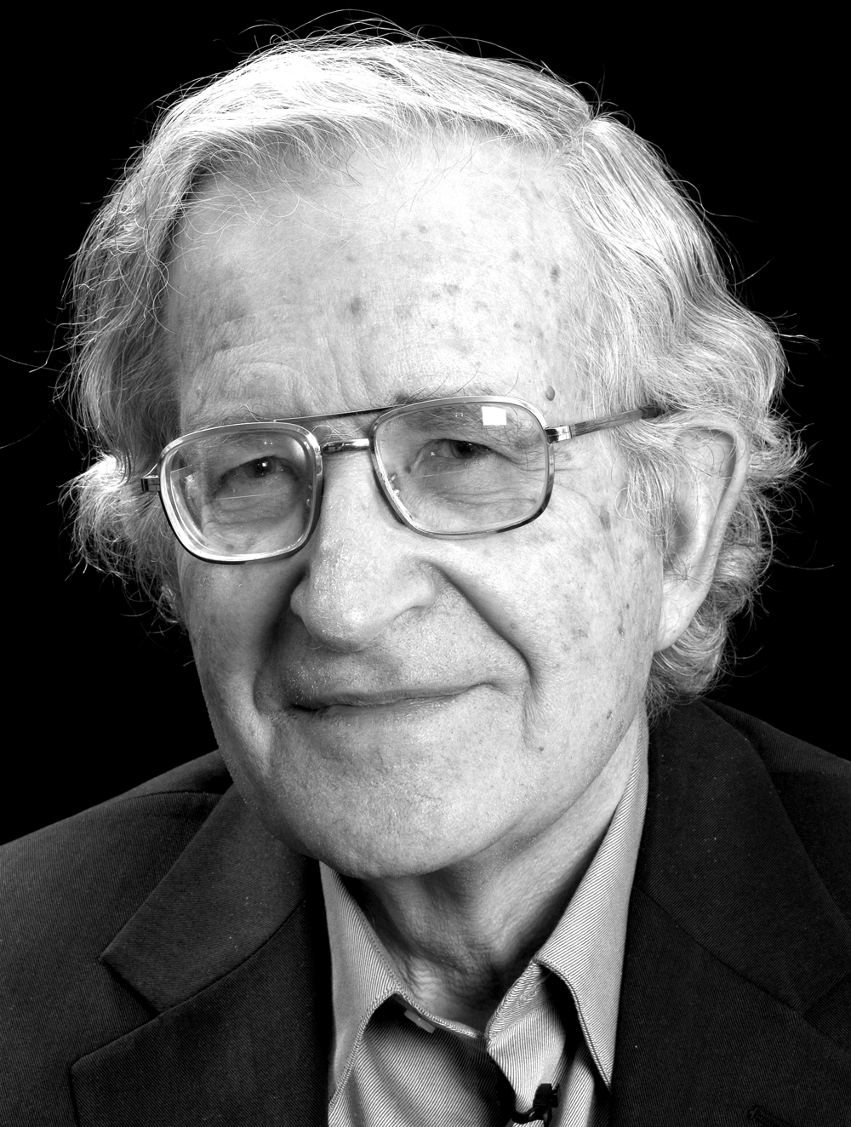
1970s
2000s
1990s
1950s
2020s

Slide 4
Behaviourism vs Innatism
Behaviorist view
Language is learned through interaction with the environment.
Emphasis on stimulus-response conditioning.

Slide 5
Chomsky’s Critique
Argued that behaviorism cannot account for the complexity of language.
Children often produce sentences they've never heard before.
Introduced the idea that language ability is innate.

Slide 6
Universal Grammar (UG)
Universal Grammar is a proposed set of innate grammatical principles shared by all humans.
Serves as the foundation for all human languages.
Suggests that the ability to learn grammar is hard-wired into the brain.

Slide 7


Evidence for UG
Instruction Children acquire complex grammatical rules rapidly and with little explicit instruction.
Patterns Language development follows similar patterns across different cultures and languages.
Similarities There are fundamental structural similarities among the world's languages.

Slide 8
Language Acquisition Device (LAD)
The LAD is a hypothetical brain mechanism pre-wired for language learning.
It is equipped with the principles of Universal Grammar.
Enables children to generate and understand sentences they have never heard before.

Slide 9
Role in Language Development
Learning Explains the ease and speed with which children learn language during early childhood.
Activation Suggests that minimal exposure to language activates the LAD.
Grammatical Structures Facilitates the acquisition of complex grammatical structures without formal instruction.

Slide 10
Competence vs Performance
Linguistic Competence
Linguistic Performance
Distinction
Refers to an individual's internalized knowledge of their language's rules and structures.
Represents the subconscious understanding that enables the production and comprehension of sentences.
Is considered idealised and free from errors or limitations.
The actual use of language in real-life situations.
Can be influenced by factors such as memory constraints, distractions, and errors.
May not always accurately reflect an individual's linguistic competence.
Chomsky focuses on competence to study the inherent capabilities of the human mind regarding language.
Emphasises that performance can be variable and is not the best measure of linguistic knowledge.
Understanding competence helps in uncovering the universal aspects of language.

Slide 11
Deep/Surface Structures
Deep Structure
The underlying, abstract syntactic organisation of a sentence that conveys its fundamental meaning.
Surface Structure
The final syntactic form of a sentence that results from transformations applied to the deep structure.

Slide 12
Transformational Grammar
A system of rules that transforms deep structures into surface structures.
Accounts for the relationships between different sentence forms that share the same meaning.
Explains how complex sentences can be generated from simple underlying representations.

Slide 13
Examples
Active "The boy threw the ball."
Passive "The ball was thrown by the boy."
Explanation Both sentences have the same deep structure but different surface structures due to transformational rules.

Slide 14
Generative Grammar
A theory that proposes a finite set of rules can generate an infinite number of grammatical sentences.
Focuses on the innate structures that allow humans to produce and understand language.

Slide 15
Generative Grammar
Recursive Nature of Language
Impact on Linguistics
Language allows for the embedding of clauses within clauses, enabling endless sentence creation.
Recursion is a key feature that contributes to the infinite generative capacity of language.
Shifted the study of linguistics from merely describing language to explaining its underlying structure.
Encouraged the development of formal models to represent linguistic knowledge.
Influenced various fields, including computer science and artificial intelligence.

Slide 16
Impact on Cognitive Science
Chomsky's theories suggest that the human brain is pre-equipped with structures for language learning.
Influenced research on the nature of human cognition and the mind's innate capacities.
Contributed to debates on the nature versus nurture aspects of cognitive development.

Slide 17
Critiques of Chomsky’s Theory
Some linguists argue that language can be learned through interaction and does not require innate grammar.
Usage-based models emphasize the importance of social interaction and frequency in language acquisition.
Critics point out that Chomsky's theories may not account for all linguistic diversity and language change.

Slide 18
Noam Chomsky on Language
Summary of Key Points
Relevance Today
Final Thoughts
Chomsky introduced the idea of an innate language faculty with Universal Grammar and the LAD.
Distinguished between linguistic competence and performance.
Developed concepts of deep and surface structures and transformational grammar.
His theories continue to influence modern linguistic research and cognitive science.
Provides a framework for exploring how language is processed and represented in the mind.
The debate over the innate versus learned aspects of language remains active.
Chomsky's work has laid the groundwork for ongoing exploration into human language and cognition.
Future research may integrate his theories with alternative models for a more comprehensive understanding.

Slide 19


